Slide 1
SMART IRRIGATION SYSTEM
Shaheer Aslam
S5268496

Slide 2
List of contents
Introduction
Sensors and micro-Controllers
Project Breakdown
MQTT Protocol
Ubidots
Conclusion
Future Improvements

Slide 3
Introduction
Smart irrigation systems have become increasingly popular due to their ability to conserve water and improve crop yields. This project aims to develop an IoT-based smart irrigation system that can determine humidity, temperature, moisture, and send the data to Ubidots using MQTT protocol.
Wokwi is a web-based platform that allows us to simulate and test our projects using virtual components. It provides a virtual environment where we can design and test our projects without the need of physical components or dedicated test bench. We have used this simulator for our project Smart Irrigation System.

Slide 4
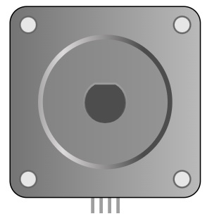
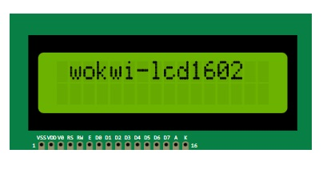
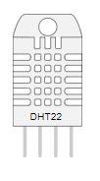
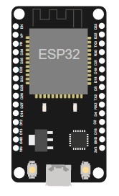

Sensors and Microcontrollers
A bipolar stepper motor
An LCD with 2 lines, 16 characters per line
Digital Humidity
and Temperature
sensor.
Soil Sensor
The ESP32 is a WiFi and
Bluetooth-enabled microcontroller

Slide 5
Project Breakdown
We start off by including the necessary libraries and defining constants such as the MQTT token, MQTT client name, and variable labels for the sensor data.
The code then sets up the stepper motor that controls the water pump and initializes the DHT22 temperature and humidity sensor and the LiquidCrystal_I2C library for the LCD display.

Slide 6
Project Breakdown x2
In the setup() function, the code connects to the WiFi network and MQTT broker, and sets up the MQTT client.
In the loop() function, the code first checks if the MQTT client is connected, and if not, tries to reconnect.

Slide 7
Project Breakdown x3
Then, the code reads the temperature and humidity values from the DHT22 sensor, displays them on the LCD, and checks if the temperature is above a threshold and the humidity is below a threshold. If this is the case, the water pump is turned off. Otherwise, the water pump is turned on and rotates in both directions.

Slide 8
Project Breakdown x4
Next, the code reads the soil moisture sensor value and displays it on the LCD.
Finally, the code converts the sensor values to strings, sends them to the Ubidots IoT cloud using MQTT protocol, and delays for a short period before starting the loop again.

Slide 9
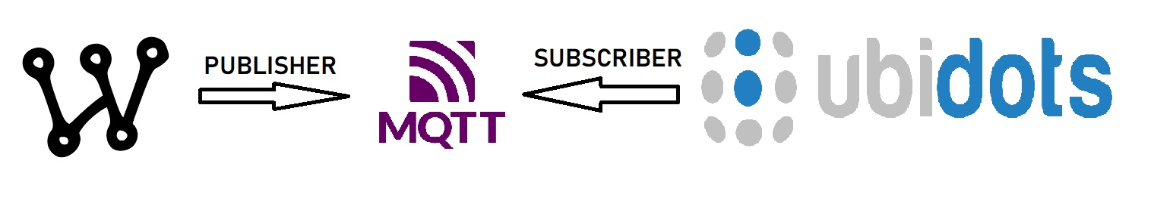
MQTT Protocol
MQTT (Message Queuing Telemetry Transport) is a lightweight messaging protocol designed for small, low-power devices and networks with unreliable connections. It is a publish-subscribe protocol, which means that messages are exchanged between devices or systems using a broker that acts as an intermediary.

Slide 10
Ubidots
Ubidots is a cloud-based platform for IoT applications that provides tools for data visualization, analysis, and management. The platform allows users to create custom dashboards to visualize data and set up alerts based on specific criteria.
In the context of the smart irrigation system project, Ubidots will be used to store and analyze the data collected by the sensors. This data can then be used to optimize irrigation schedules and improve crop yields.

Slide 11
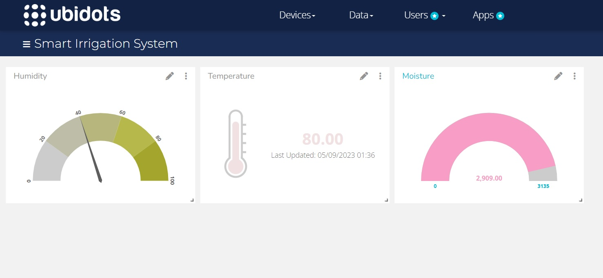
Ubidots Dashboard

Slide 12
Conclusion
In conclusion, the smart irrigation system project utilizes IoT technology to optimize water usage and improve crop yields. By using sensors to collect data on environmental conditions and transmitting this data to Ubidots using MQTT protocol, we can create a real-time system that adjusts irrigation schedules based on actual environmental conditions.
This project has the potential to significantly reduce water waste and improve agricultural productivity, making it an important step towards sustainable agriculture.

Slide 13
Future Improvements
Integration with Additional Services: The project could be expanded to integrate with additional IoT services beyond Ubidots, such as AWS IoT, Google Cloud IoT, or Microsoft Azure IoT.
Automated Alerts: It would be useful to implement a system to automatically alert users when certain conditions are met, such as when the water level drops below a certain point or when the temperature rises above a certain threshold.
Predictive Maintenance: By analyzing data trends over time, it may be possible to predict when maintenance will be required on the system, allowing for proactive maintenance rather than waiting for something to break.
Weather Monitoring: The system can be improved to detect and respond to rainfall by adding a rain sensor to the system that detects the presence of water on the surface of the soil. The sensor can then send a signal to the microcontroller to turn off the water pump when it is raining or the soil is already moist enough. This can help conserve water and prevent overwatering of the plants.

Slide 14
THANKS!

